Slide 1

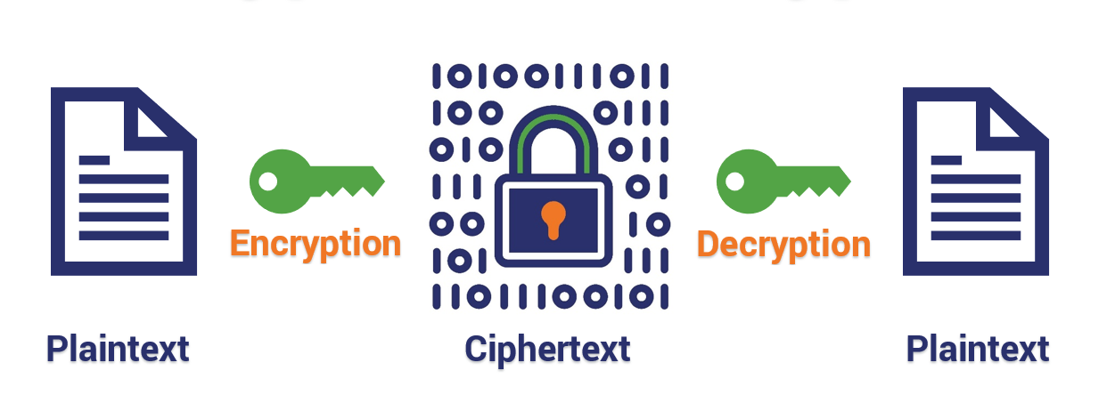
Encryption And Decryption

Slide 2

One of The World’s Largest Data Breaches
Despite a data breach, encryption ensures that an institution’s private data is safe, even when attackers get past the firewall.
AADHAR Data Breach
Date : March 2018
Impact : 1.1 billion people
This massive data breach was the result of a data leak on a system run by a state-owned utility company. The breach allowed access to private information of Aadhar holders, exposing their names, their unique 12-digit identity numbers, and their bank details.
The type of information exposed included the photographs, thumbprints, retina scans and other identifying details of nearly every Indian citizen.

Slide 3
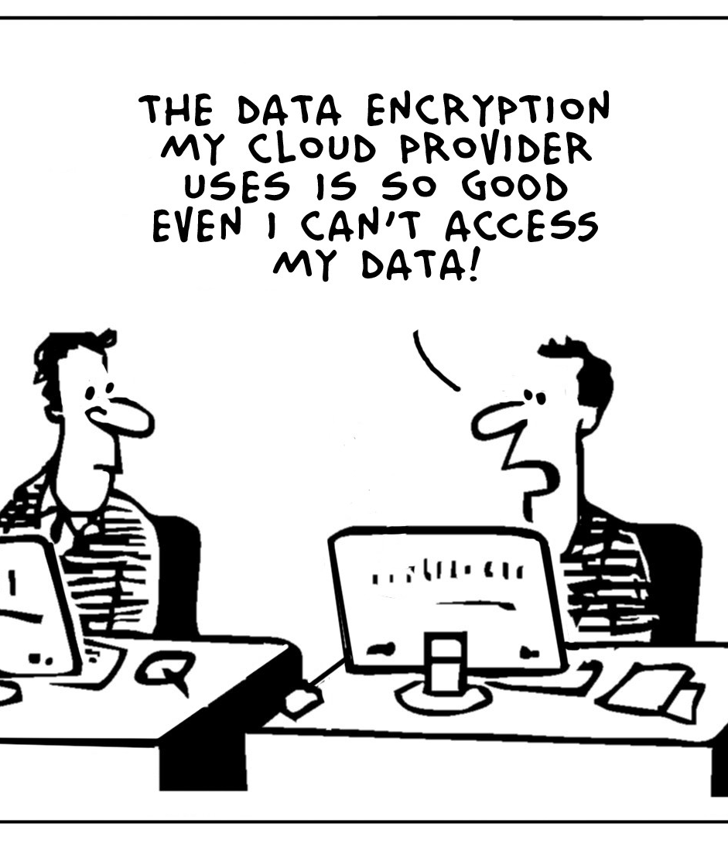
What is Encryption?
Encryption is the process of encoding data or message so that it cannot be understood by anyone other then its intended recipient.
Encryption is designed to protect important information from prying eyes by turning plaintext (readable-to-humans) data into a string of ciphertext, which is impossible to read without the proper decryption key.

Slide 4
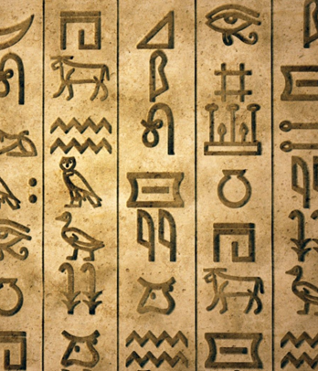
A Brief History Of Encryption
The word encryption comes from “Krypto”, the Greeks used “Krypto” to describe something that was hidden or secret.
Encryption has been in use since well before most people could read or write. The first documented instance of written cryptography dates back to 1900 B.C., when an Egyptian scribe used non-standard secret symbols in an inscription.

Slide 5
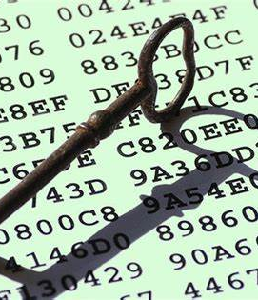
Decryption
The technique of decoding the encrypted data is known as decryption.
The recipients must have the right decryption or decoding tools to access the original details. Decryption is performed using the unique keys, codes, or passwords. The original file can be in the form of text files, images, e-mail messages, user data, and directories
The decryption algorithm is also known as a cipher.

Slide 6
Some Major Encryption Algorithms
RSA
Named After its Creators :
Rivest , Shamir and Adleman.
Triple DES
Triple DES is a block cipher algorithm that was created to replace its older version Data Encryption Standard(DES)
AES
Advance Encryption Standard also abbreviated as AES, is a symmetric block cipher which is chosen by United States government
to protect sensitive data.
TwoFish
Twofish, being a symmetric encryption algorithm, uses a single key to both encrypt and decrypt data and information. It accepts the key along with the plaintext information. This key then turns the information into ciphertext

Slide 7
Algorithm We have Used In Our Project
RSA :-
RSA is an asymmetric key algorithm.
It was introduced in 1977 , by MIT colleagues Rivest , Shamir and Adleman.
It is generator of public key and private key.
Public Key and Private Key are kept different . Thus making it more secure algorithm for data security.

Slide 8
The idea of RSA is based on the fact that it is difficult to factorize a large integer.
The public key consists of two numbers where one number is a multiplication of two large prime numbers.
And private key is also derived from the same two prime numbers.

Slide 9
RSA Algorithm Used In
RSA is generally used in software for verifying that software updates are from original developer.
Transport Layer Security , which is used by HTTPS , so RSA may be used in any connection to an https: URL.
RSA algorithm is used for digital signatures. A sender can sign a message using their private key, and the receiver can verify the signature using the sender’s public key.

Slide 10
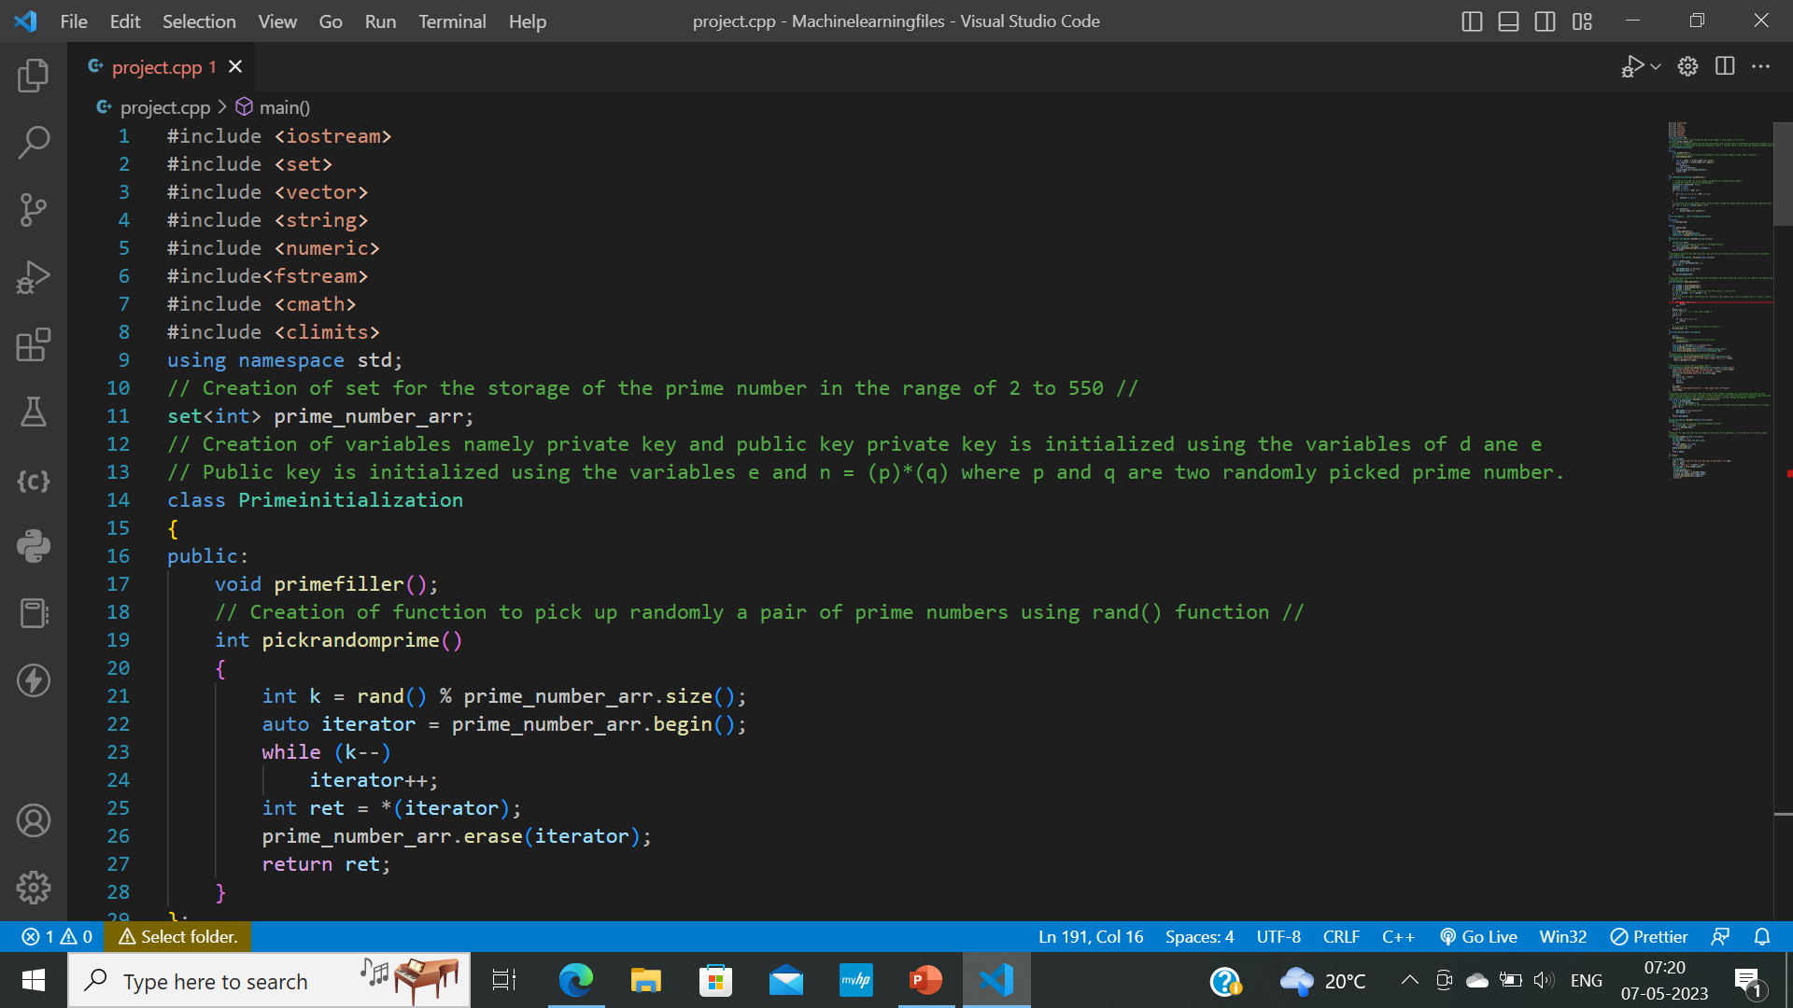
Some Glimpses Of Our Source Code
HEADER FILES

Slide 11

SEIVE FUNCTION

Slide 12

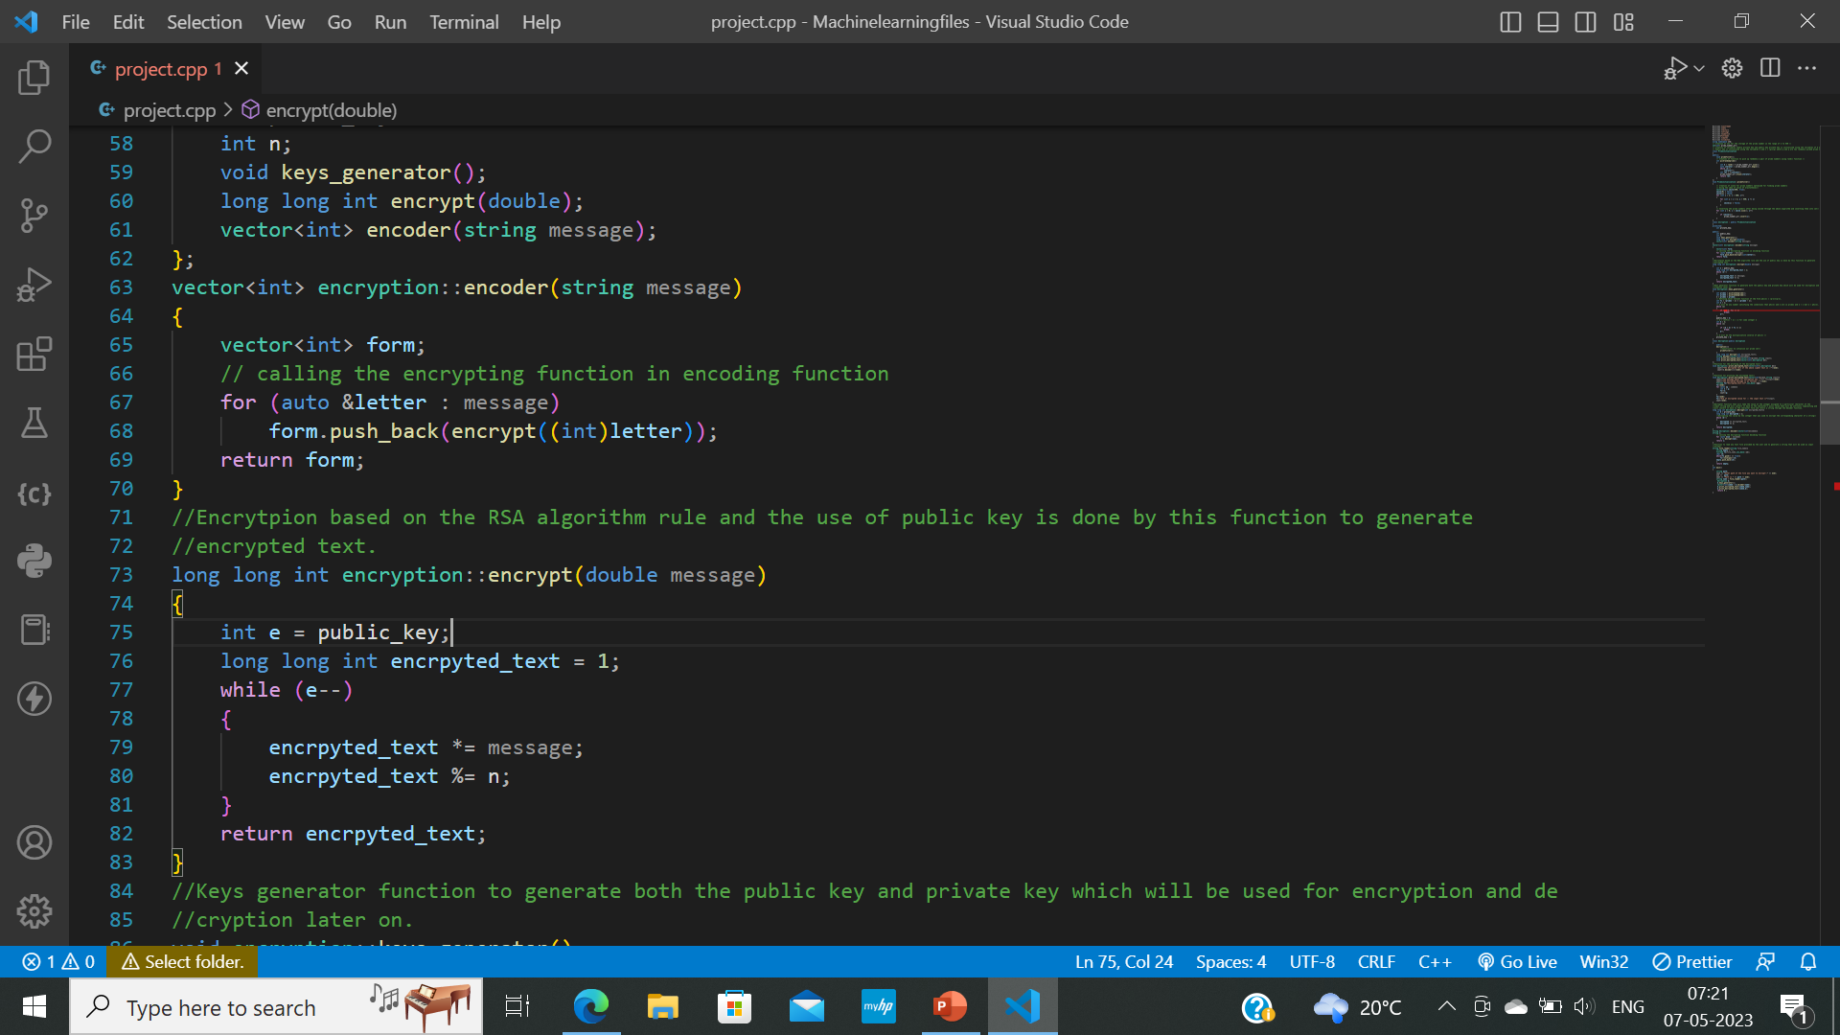
CREATION OF PUBLIC AND PRIVATE KEY

Slide 13
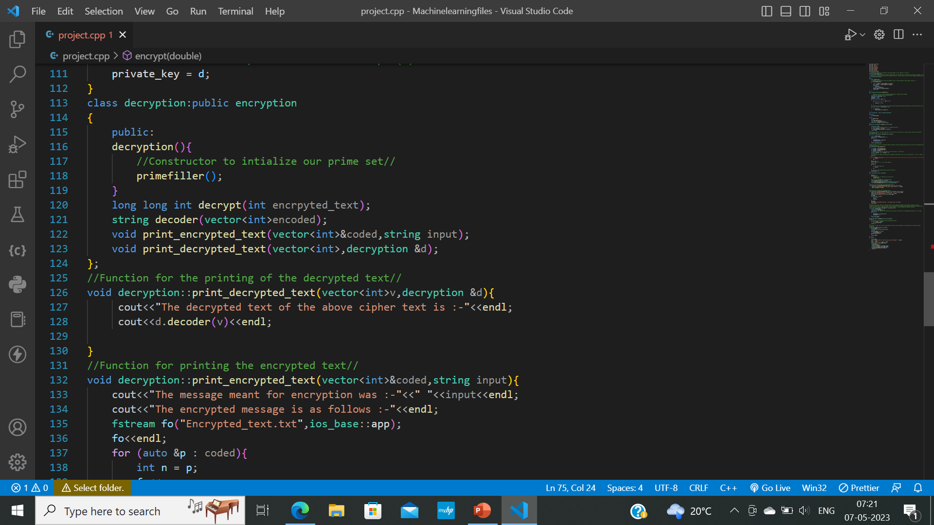
DECRYPTION CLASS

Slide 14


Slide 15
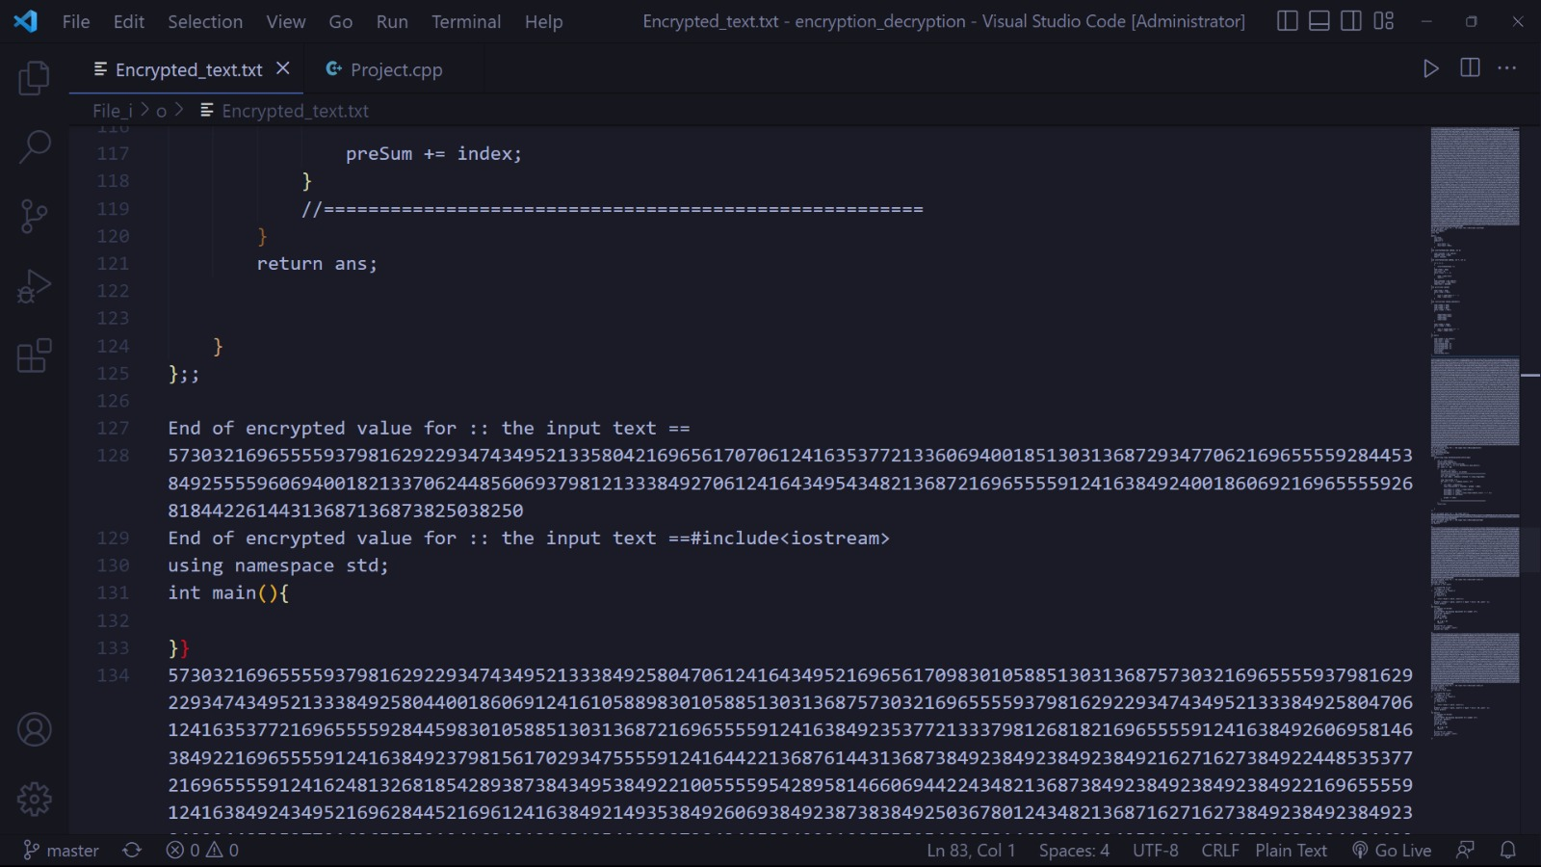

Slide 16
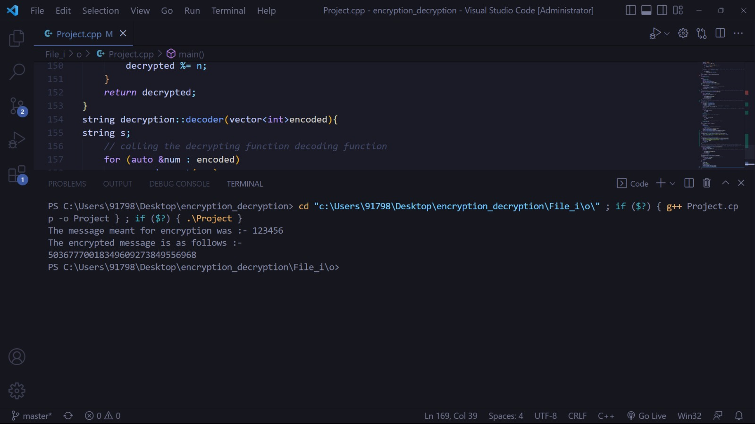
ENCRYPTED TEXT AS OUTPUT

Slide 17
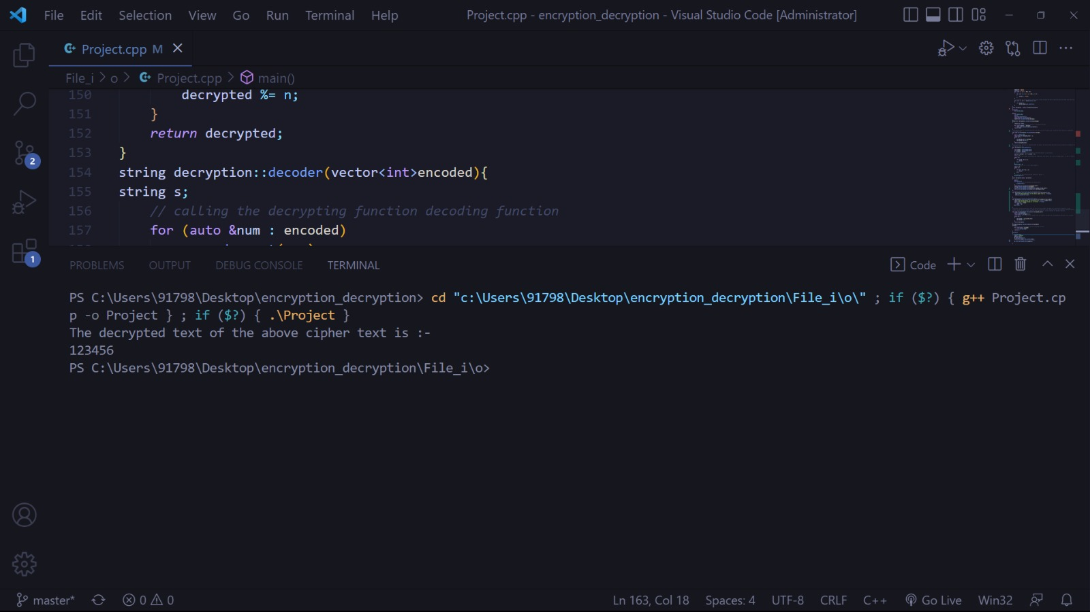
DECRYPTED TEXT AS OUTPUT

Slide 18
Most Significant Data Breaches In India in the Recent Years
Aadhar data breach.
The data breach at Air India.
The data breach at BigBasket.
The cyberattack at Just Dial.

Slide 19

Future Technology To be Designed with Security
Smart
Open
Trusted
Strong
Ubiquitous

Slide 20
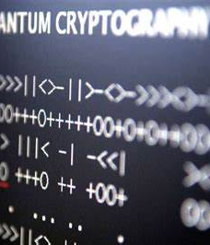
Quantum Cryptography : The Future Ahead
The uncertainty principle of quantum physics builds the earliest foundations for quantum cryptography.
It is used to establish a shared, secret and random sequence of bits to communicate between two systems. This is known as Quantum Key Distribution.

Slide 21
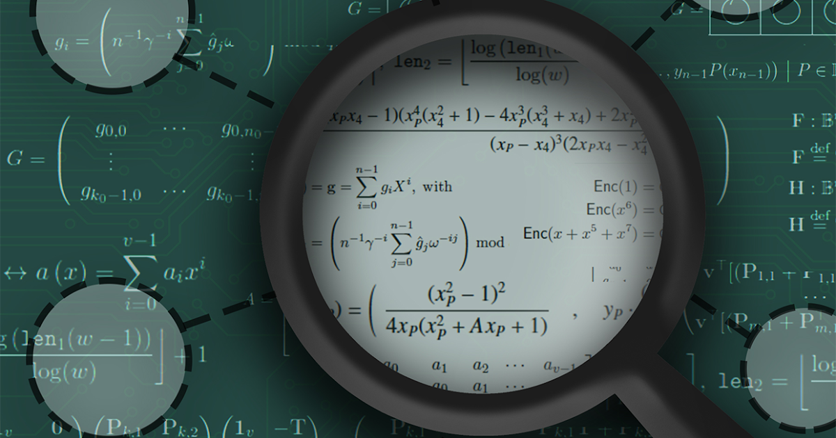
Applications Of Quantum Cryptography
Financial transactions
Military and government communication
Healthcare
Internet of Things (IoT)

Slide 22
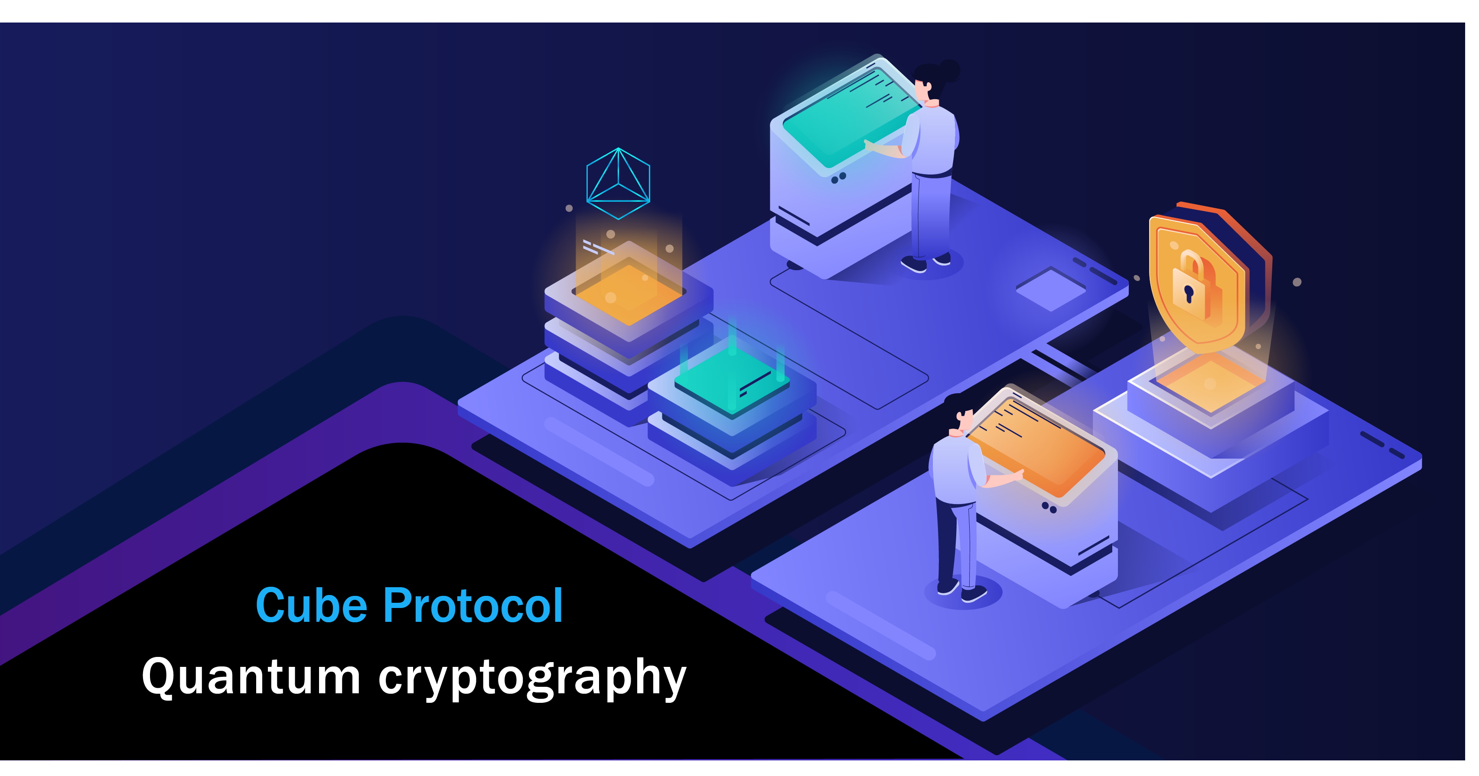
Advantages Of Quantum Cryptography
Unconditional security
Key distribution
Speed
Long-term security

Slide 23
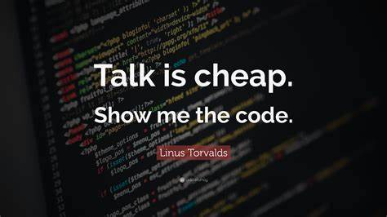
https://github.com/Sansh2356/Encryption_decryption_1st_draft

Slide 24


